Slide 1
What is AI? What are AI solutions?
Stefan Schlobach
September 14, 2021

Slide 2
Organisational Matters
Part 1

Slide 3

Guest Lectures: Summaries and reflections
Guest lectures: summaries and reflections
2 Points per reflection (16 points in total)
Methodological Lectures: no summaries and reflections (but apply in projects)
Still to come:
Mark Hoogendoon (ML)
Koen Hindriks (Social AI)
Guszti Eiben (Compt Intelligence)
Ilaria Tiddi (Hybrid Intelligence)
Marieke van Erp (AI in Digital Humanities)
Paul Groth (Data Engineering)
Emma Beauxis-Aussalet (AI and Ethics)
Determining the problem (Ilaria Tiddi)
Finding Literature (Ilaria Tiddi)
Knowledge Elicitation (Ilaria Tiddi)
Solutions (Stefan Schlobach)
Evaluation (Sara Lusini)

Slide 4
Final Assignment
A 12 pages (in English) scientific report 60 Points/100
Introduction (1 page)
What is the problem? (2 pages)
What has been done? (3 pages)
How can the problem be solved? (3 pages)
Is the solution valid? (2 pages)
Conclusion (1page)

Slide 5
Final Assignment (cont)
Video (90 Seconds) 15 Points
Poster (A3) 9 Points

Slide 6
Best “Intro AI project” price
To be determined

Slide 7

Academic integrity
Part 2
https://lo.unisa.edu.au/mod/book/view.php?id=252142

Slide 8
Academic integrity
1. Honesty: “Academic communities of integrity advance the quest for truth and knowledge through intellectual and personal honesty in learning, teaching, research, and service”
2. Trust “Academic communities of integrity both foster and rely upon climates of mutual trust. Climates of trust encourage and support the free exchange of ideas which in turn allows scholarly inquiry to reach its fullest potential”
3. Fairness “Academic communities of integrity establish clear and transparent expectations, standards, and practices to support fairness in the interactions of students, faculty and administrators”
References: International Centre for Academic Integrity. (2013). The fundamental values of academic integrity. Retrieved from https://healthsciences.humber.ca/current-students/academic-integrity/six-values.html

Slide 9
Academic integrity 2
4. Respect “Academic communities of integrity value the interactive, cooperative, participatory nature of learning. They honour, value, and consider diverse opinions and ideas”
5. Responsibility “Academic communities of integrity rest upon foundations of personal accountability coupled with the willingness of individuals and groups to lead by example, uphold mutually agreed-upon standards, and take action when they encounter wrongdoing”
6. Courage “Translating the values from talking points into action—standing up for them in the face of pressure and adversity—requires determination, commitment, and courage”
References: International Centre for Academic Integrity. (2013). The fundamental values of academic integrity. Retrieved from https://healthsciences.humber.ca/current-students/academic-integrity/six-values.html

Slide 10
Taking Stock: where are we?
Part 3

Slide 11
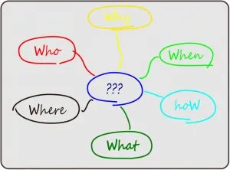
Defining the problem
https://txm.com/learning-to-define-the-problem/

Slide 12

Sota: Finding Literature
https://www.iamexpat.nl/lifestyle/lifestyle-news/most-beautiful-libraries-netherlands

Slide 13
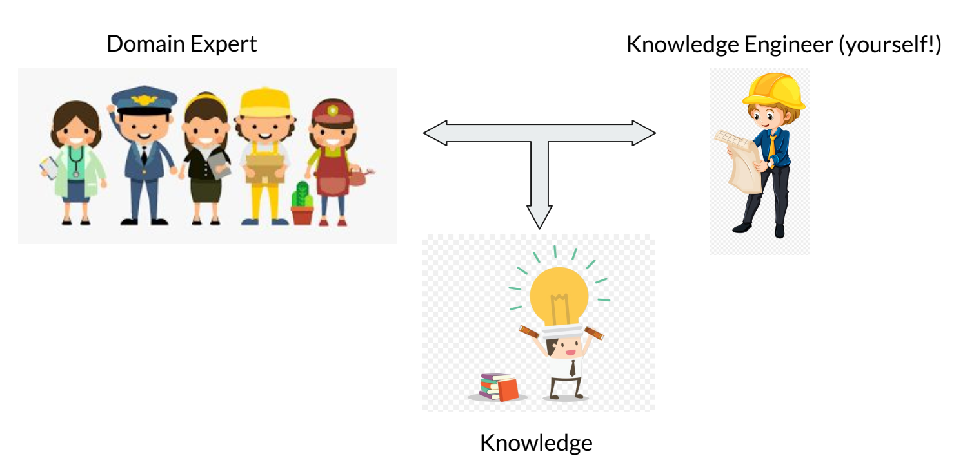
Sota: Literature is not all…Knowledge Elication

Slide 14
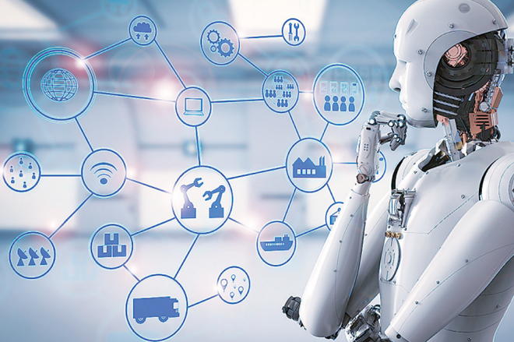
Next: Building AI Systems

Slide 15
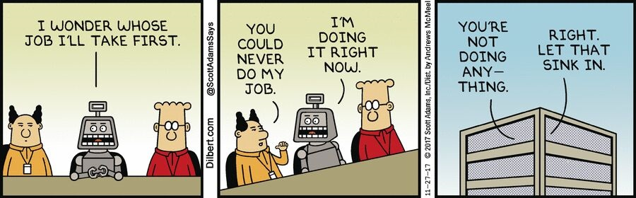
Still to come: Evaluation of (AI) Systems
https://www.datasciencecentral.com/profiles/blogs/enterprise-ai-learning-from-the-evolution-of-robotic-process

Slide 16
What is AI?
Part 4
Notes:
Machines that mimic “cognitive”functions that humans associate with the human mind.

Slide 17
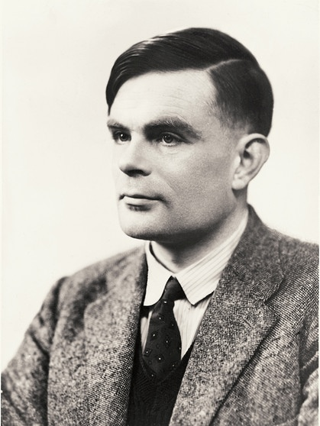
Quiz: who is this guy?
And why should you know him?

Slide 18
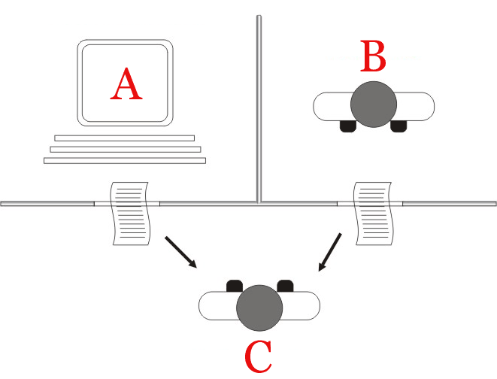
Human Intelligence
Notes:
“Are there imaginable digital computers which would do well in the imitation game?”
Here is the Turing test, a famous though experiment. Rather than asking for a definition of intelligence, which we are unlikely to achieve anytime soon, it proposes to work from the way we prescribe intelligence to the only systems we currently know that are capable of exhibiting it: other people.
While we can sense our own intelligence, we can only infer the intelligence of other people. If we are being entirely skeptical we may well doubt that other people have possess consciousness. Perhaps they are simply “philosophical” zombies, perfectly faking their responses. We don’t usually worry about this and are happy to assume that they have intelligence.
By that rationale, we should be equally happy to assume that a machine has intelligence, if we cannot tell its responses apart from a human being. This is what the turing test specifies: an interrogator talks to a human being and a machine, both sealed in separate rooms, through a chat interface. If the interrogator cannot tell human from machine, it has no basis to say that the machine cannot think.
If you’re interested in this sort of stuff, I recommend reading the original paper. It’s pretty easy to digest: https://www.csee.umbc.edu/courses/471/papers/turing.pdf

Slide 19
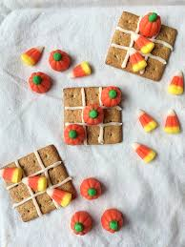
Complex algorithmics
If two in a row/column/diag, take remaining
Else, if a move creates 2 in a r/c/d twice, play
Else, take the center if free
Else if opponent has played in a corner, take opposite corner
Else, take empty corner if exist,
Else take any empty square

Slide 20
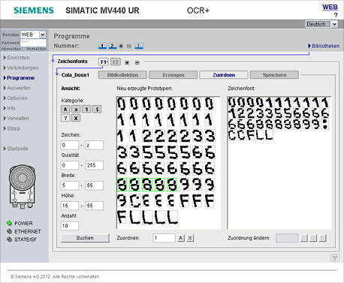
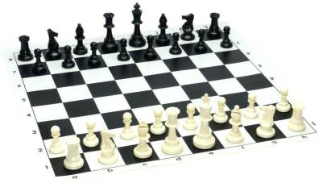
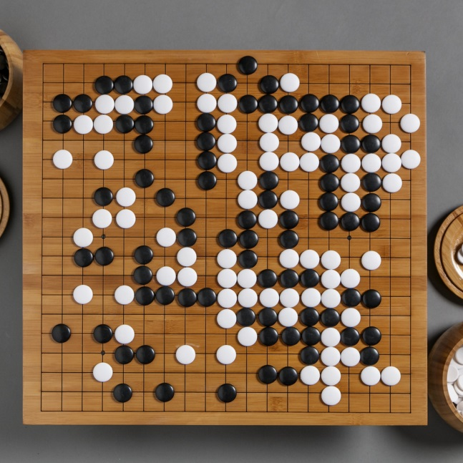
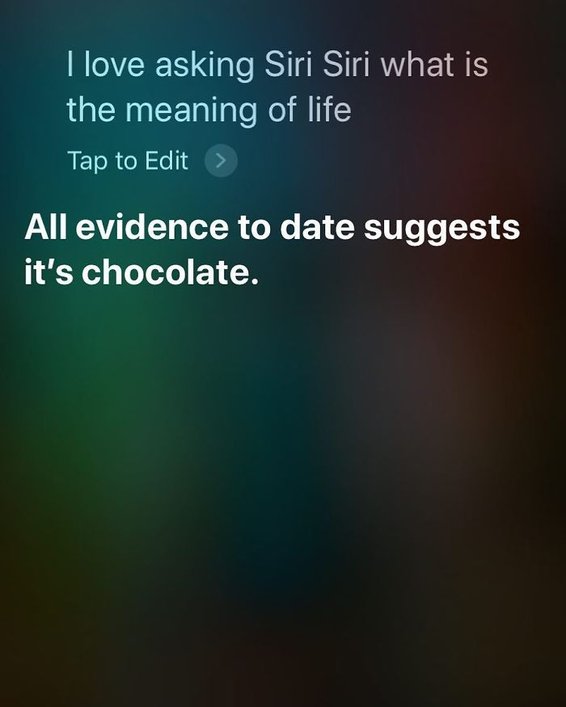
Complex algorithmics

Slide 21

Horizon effect of AI
Notes:
Tasks that are solved by AI are often removed from the definition:
Optical character recognition
Speech recognition
Automated Assistants (Siri, Alexa)
Autonomous driving Checkers
Chess
Go
Question Answering

Slide 22
Rationality
An “Intelligent Agent” is a device that perceives its environment and takes actions that maximize its chance of successfully achieving its goals.

Slide 23
2 Types of AI
Part 5

Slide 24
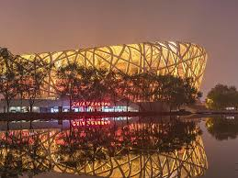
Weak AI
Machines behave Intelligently in specific domains:
Game playing
Information retrieval
Speech Recognition
Producing art
Creative problem solving
Notes:
The simplest claim in response to the question “can machines think” is that of weak AI: in specific domains machines can outperform humans. Nowadays, there is plenty of evidence that this is true. There are, however enough areas left, where we have no idea how to build a machine that does what we can do.

Slide 25
Strong AI
Machine intelligence equal in breadth and depth to that of humans.

Slide 26
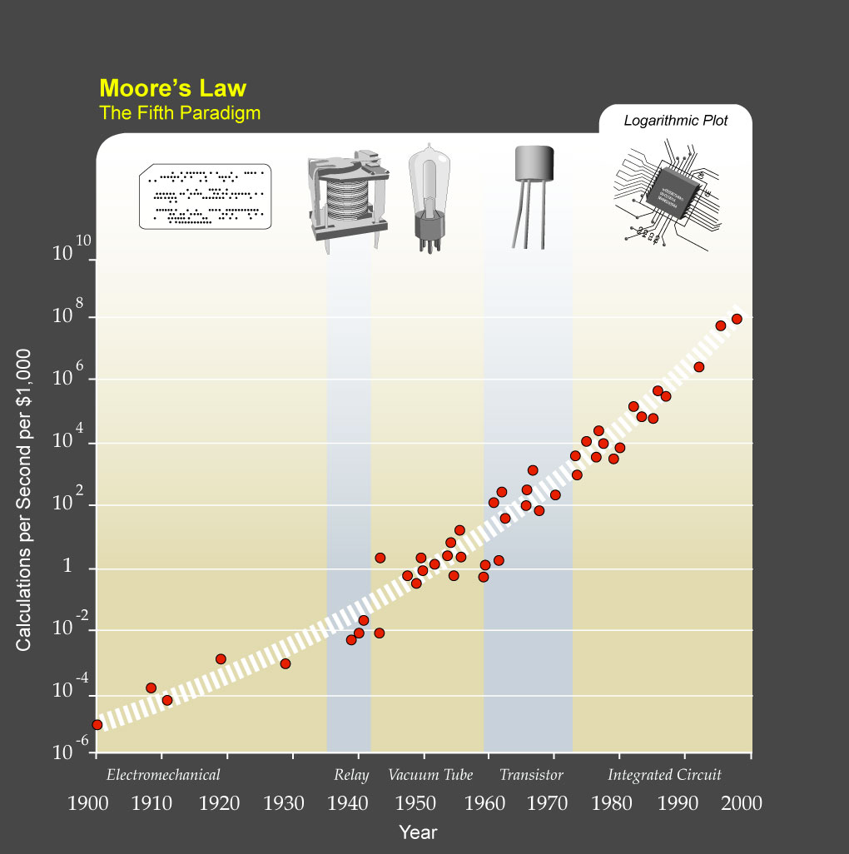
Rate of progress
Stone tools (2 600 000 ya)
Hafting (500 000 ya)
Agriculture (~10 000 ya)
Writing (6 000 ya)
Steam engine (200 ya)
Flight (100 ya)
Space flight (50 ya)
Notes:
Here is a little picture of the rate of progress of human invention. Hafting basically means working stone tools into axes, arrows and spears. The examples are very selective (and it should be noted that between stone tools and agriculture we actually changed species and genus (from australopithecus afarensis to homo sapiens). Nevertheless, it’s striking that within one generation we went from the invention of powered flight to landing on the moon, amor from the first computer to the internet, yet it took us two million years to work out that we could tie a rock to a stick.
On the left is a more recent example: Moore’s law, which suggests that the number of transistors on a single CPU double every 18 months. More broadly the number of calculations you can per second for 1000$ has similarly increased exponentially from one million seconds per calculation in 1900 (by mechanical means) to about a billion per second.
No exponential increase can continue indefinitely. Where will this end? Will we see major technological breakthroughs on a daily basis? On an hourly basis? Or will this rate of increase culminate in some event? Von Neumann, a mathematician working in the 1950s coins the phrase the singularity. For the event, whatever it is, that means the end of our exponential rate of progress.
image source: By Courtesy of Ray Kurzweil and Kurzweil Technologies, Inc. - en:Image:PPTMooresLawai.jpg, CC BY 1.0, https://commons.wikimedia.org/w/index.php?curid=1273707

Slide 27

The singularity
Median predicted date: 2040 (http://library.fora.tv/2012/10/14/Stuart_Armstrong_How_Were_Predicting_AI)
Notes:
Some people (futurists rather than scientists) proclaim that the moment the bubble will burst, the singularity, will occur when we build an AI that is not necessarily Strong, but better at building AIs than us. Essentially, we AI researchers are perpetually putting people out of a job, and the last people we put out of a job will be ourselves. The predictions for exactly what will happen range very widely. Some say we will be killed by our AIs, some say we will be uploaded into the clouded, merging with our machine children and some say we will be kept alive and cared for, but we will become entirely irrelevant.
It’s a difficult question to discuss in concrete terms, but more and more people are taking the threat seriously, and the questions are starting to become more concrete.
Further reading:
http://www.bbc.com/news/technology-30290540
http://www.theverge.com/2016/6/2/11837566/elon-musk-one-ai-company-that-worries-me
http://www.theverge.com/2015/12/11/9910742/elon-musk-openai-sam-altman-y-combinator-machine-learning

Slide 28
Interpretable AI
Can we build a Strong AI in a way that we understand?
Interpretable weak AI:
Do we understand Go any better?
Do we understand vision any better?
Do aeroplanes help us understand birds?
Notes:
Interpretable AI is another level above strong AI. Imagine that we faced a skeptic of String AI and we provided him with the brain-simulation argument. His reply is: sure you could simulate a brain neuron for neuron (at least in principle), and I agree it would behave as intelligently as a human being. But I doubt that you could write a computer program that would simplify intelligence for us. Could you write a Strong AI in a way that you could understand? In a way that would allow us to comprehend where intelligence come from and to find the line between a simple combination of components and a fully fledged intelligence with an internal life as rich as our own?

Slide 29
Generic AI - problem Classes / Goals & - typical related solutions
Part 6
Very simplified. Usually there are combinations of approaches needed

Slide 30
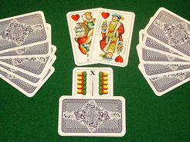
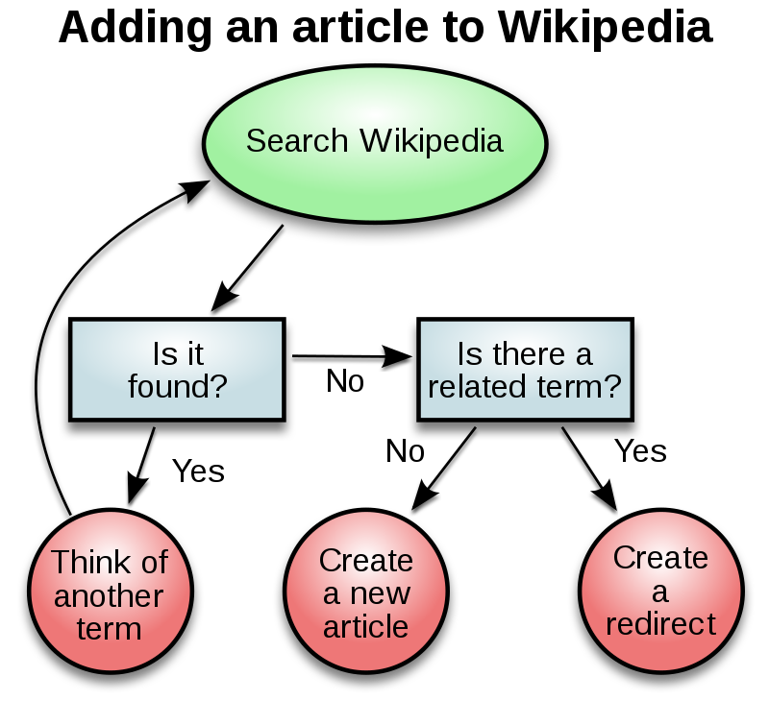
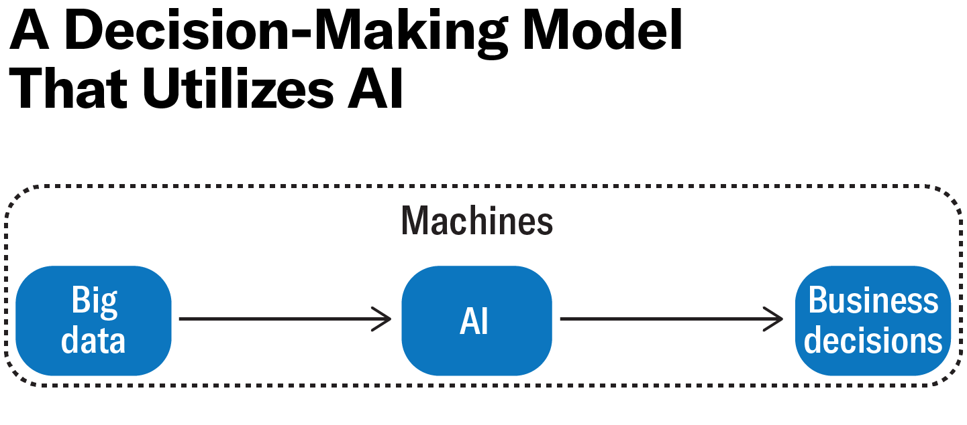
Decision Making / Problem solving

Slide 31
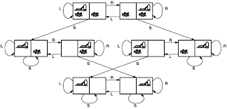
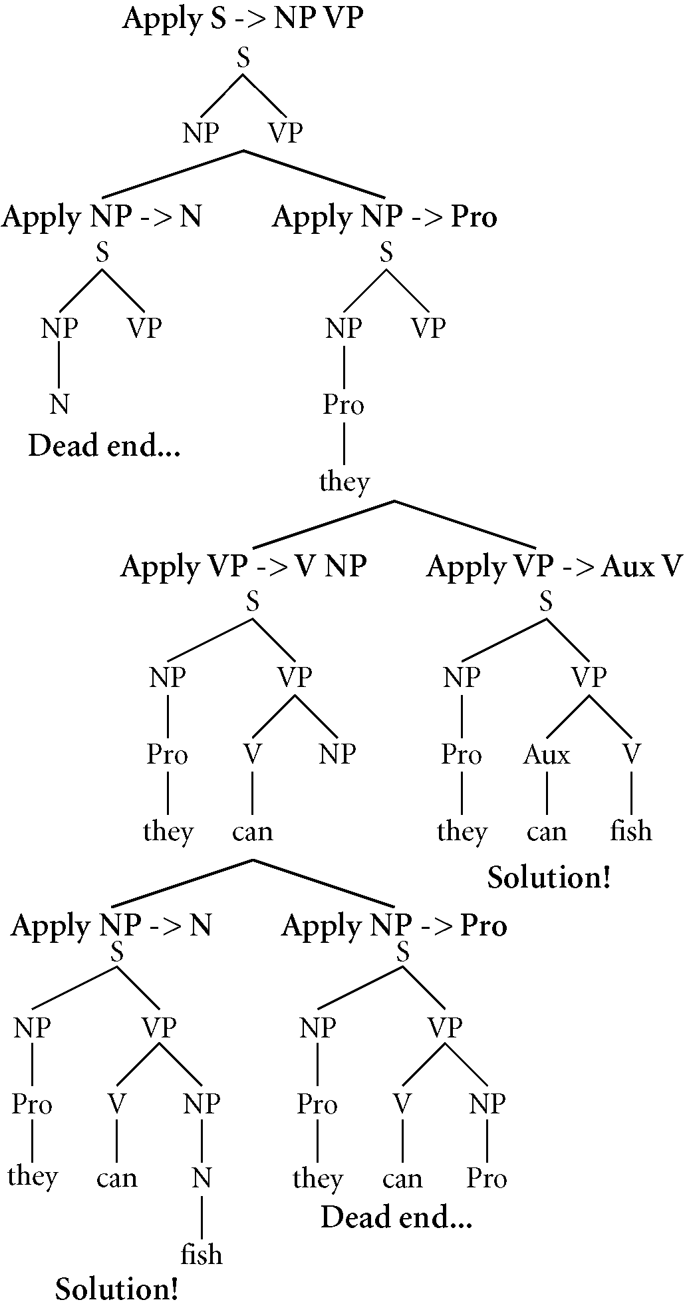
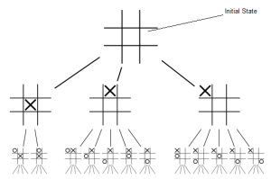
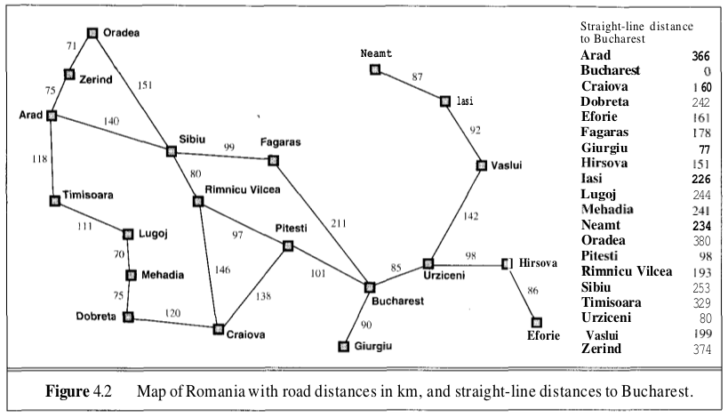
State-space representations and search

Slide 32
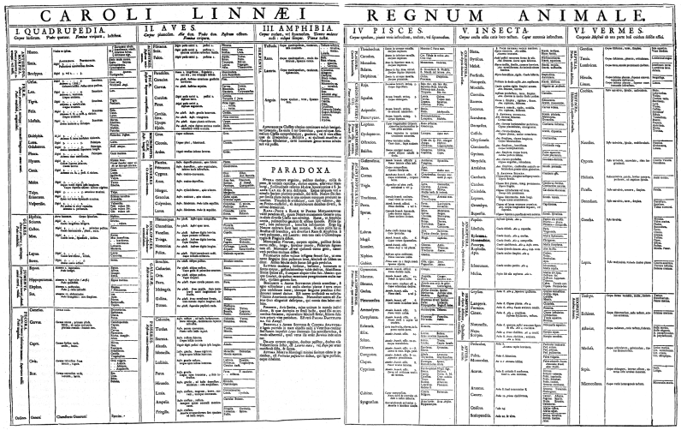

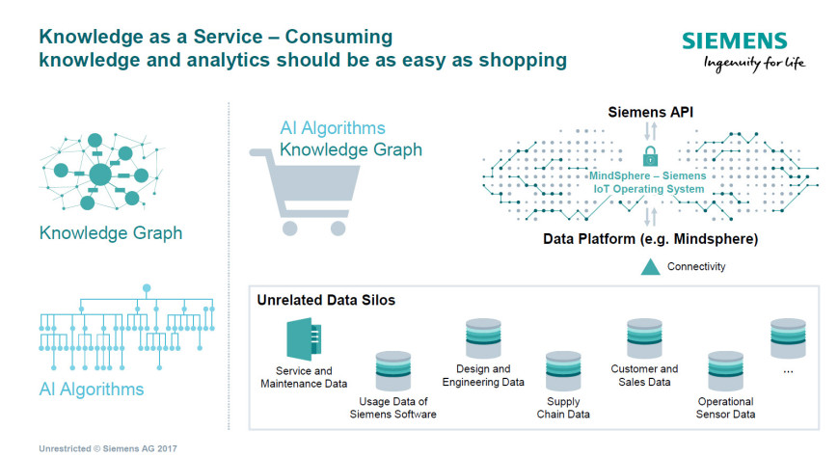
Knowledge Representation
Making sense of / explaining the world
Interpreting perceptions
Organising knowledge
Conceptionalising phenomena
Useful for:
Question Answering
Decision support
Data Integration
Disambiguation

Slide 33
Logics
Propositions
Predicates
Objects and instances / Graphs (Description Logics)
Modal logics (belief, epistemic)
Temporal
Non-monotonic / Default
Fuzzy
Probabilistic

Slide 34
Reasoning
Reason is the capacity of consciously making sense of things, establishing and verifying facts, applying logic, and adapting or justifying practices, institutions, and beliefs based on new or existing information
Deductive: produce new explicit statements from implicit ones.
Inductive: produce explicit statements for unobserved objects.
Abduction: produce statements that explains known statements.
Case-based reasoning: solve problems based on solutions to similar problems

Slide 35
Reasoning: A world of approaches
Nowadays often both symbolic and sub-symbolic approaches, or combinations of the two, even for induction
Inductive Logic Programming
(Statistical) Machine Learning
Automated Reasoning / Theorem Proving
Notes:
Show Truth Tables complexity

Slide 36
Learning
Machine learning (ML) is the scientific study of algorithms and statistical models that computer systems use to perform a specific task without using explicit instructions, relying on patterns and inference instead.
Supervised learning
Classification
Regression
Unsupervised
Clustering

Slide 37
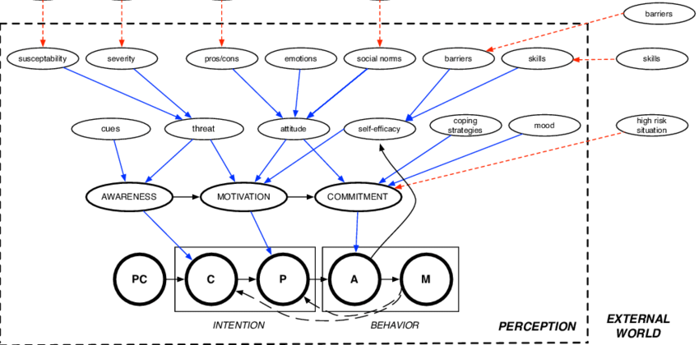


Approach: Modelling and simulation

Slide 38
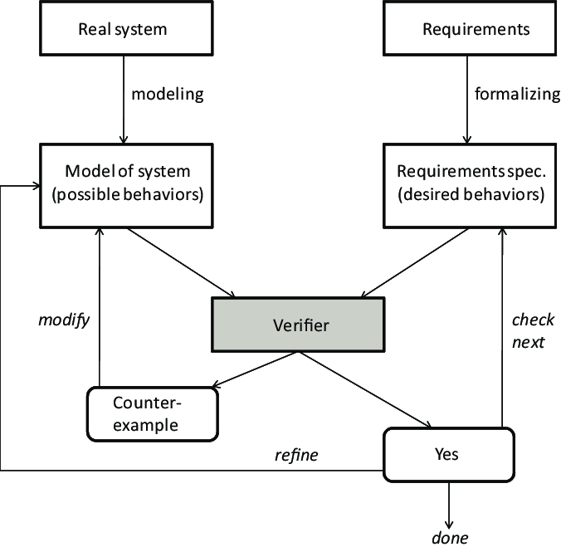
Formal Verification and Model Checking

Slide 39
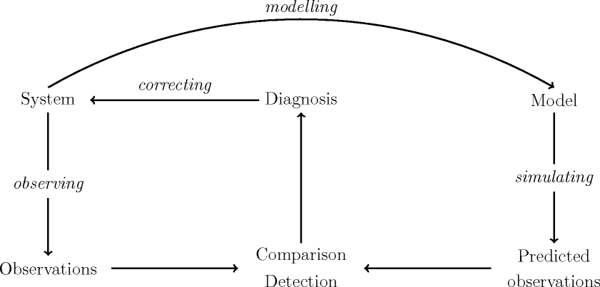
Diagnosis
Notes:
Related to Abductive reasoning
Applied in Healthcare . Systems .

Slide 40
Natural Language Processing
Natural language understanding
Understanding the structure of natural language (Syntax)
Understanding the meaning of natural language (Semantics)
Understanding the usage of natural language (Pragmatics)
Language generation
Translation

Slide 41
Automated Planning and Scheduling
Realization of strategies or action sequence
Given a description of the possible initial states of the world, a description of the desired goals, and a description of a set of possible actions, the planning problem is to synthesise a plan that is guaranteed (when applied to any of the initial states) to generate a state which contains the desired goals (such a state is called a goal state).

Slide 42
Computer Vision
How to gain high-level understanding from digital images or videos
Object detection
Object recognition
Object Identification
Motion analysis
Event detection
Emotion detection

Slide 43
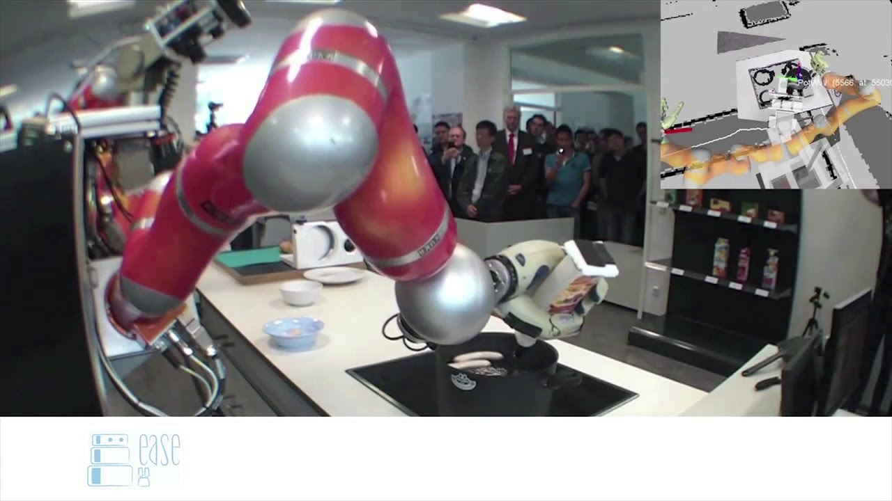
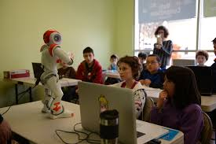
Robotics

Slide 44

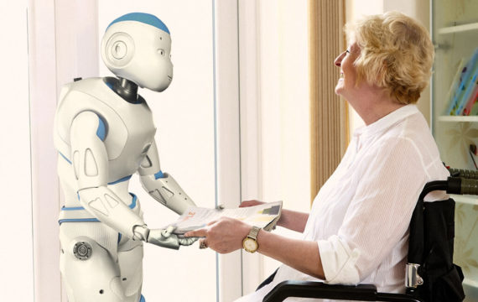
Social Intelligence

Slide 45
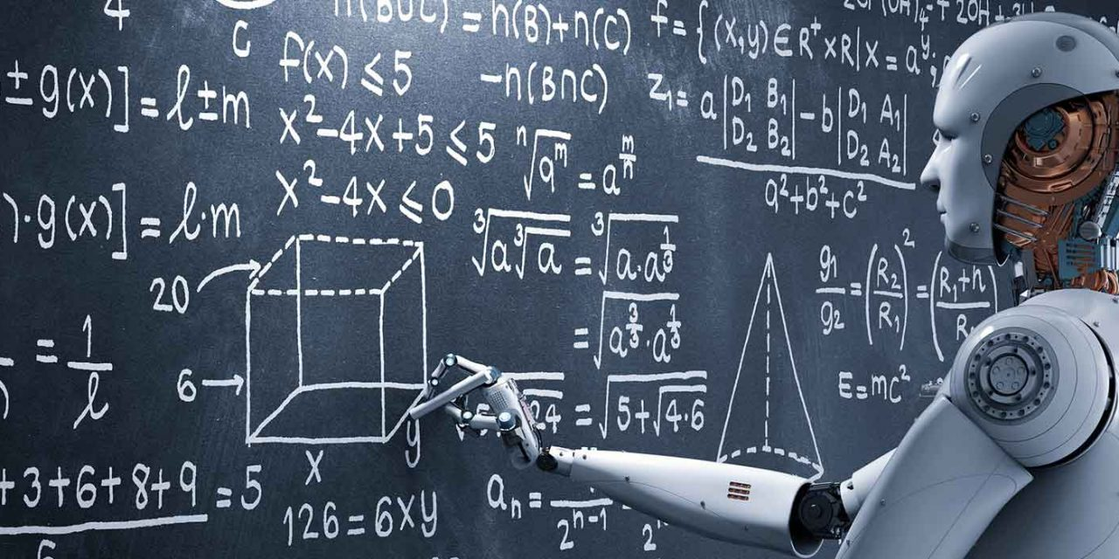
Artificial General Intelligence (strong AI)

Slide 46

Hybrid Intelligence

Slide 47
This week’s tutoring
Integration of the comments about the Research Problem
Discuss literature review about your Reseearch Problem

Slide 48

About the lectures….
https://www.menti.com
Voting code: 7448 8183

Slide 49
Next week ?
Monday: Mark Hoogendoorn
Machine Learning
Tuesday: Sara Lusini
How to evaluate AI systems

